Slide 1

Unaccompanied Housing
New Resident Orientation
Naval Base Kitsap
Bangor, Bremerton, Keyport and Naval Hospital
Notes:
As identified in NAVADMIN 181/13: Ensure all permanent party Sailors residing in barracks attend orientation training within 30 days of occupancy.
Allowing UH staff to provide New Resident orientation accommodates Installation needs; flexibility to accommodate 1 or 300 new check-ins.
Updated Guidance will be included in revision of Ops Guide (turning into a SOP (i.e.. reminiscent of the P-935) Release TBD) Resourced to be accomplished this year.
-UH Orientation will be provided within 30 days of Resident check-in by UH Staff, civilian or military E6 and above, may be provided by RA
-Documentation of training will be retained in resident file
-Orientation will include:
1) Review of Welcome Aboard & Base Orientation;
2) Review of UH Rules and Regulations;
3) Discussion on who their RA is and the RA Roles and Responsibilities; and
4) Discussion on SAPR for UH residents

Slide 2
Agenda page 1
On-line services 4-5
Keys 6-7
Maintenance 8-10
Pests and Mold 11
On-line Maintenance 12
US Mail and Package delivery 13
Rules
  Room Inspections 14
  Alcohol 15-16
  Guests 17
  Smoking 18

Slide 3
Agenda page 2
Rules - continued
  Weapons 19
  Prohibited Items 20
  Cooking in Rooms 21
  Trash 22
  Parking 23
  Bicycles 24
  Damages 25
  Sprinkler Heads 26
  UH Check-out Procedures 27
  Resident Advisor (RA) Program 28
  SAPR 29-31
  NGIS and UH contact information 32-33

Slide 4
Emergency Management
Know your evacuation route / muster location
If you hear a fire alarm, evacuate the building – even if you know it is a drill and bring your roommate and neighbors – we train like we fight even in UH!
If you have questions about how UH responds to various emergencies, visit your UH Complex Manager – they are happy to discuss the UH Emergency Action Plan.

Slide 5

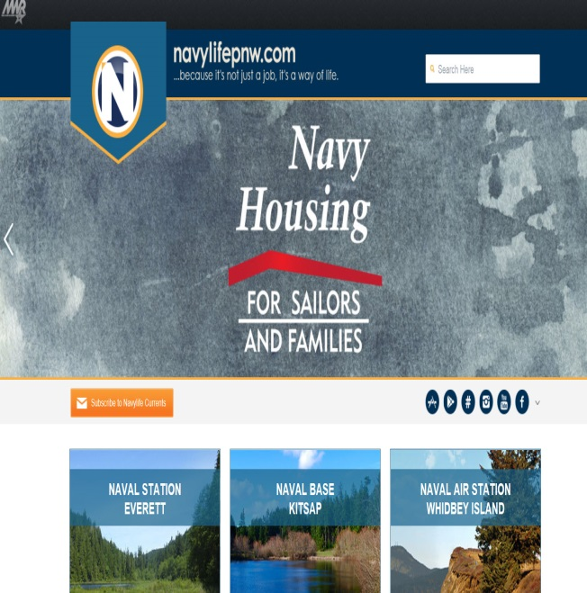
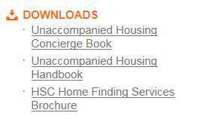
Online / Concierge services
Important information for all NBK residents is available at www.navylifepnw.com
It assists you in becoming familiar with the different UH campuses at NBK and services available.
These are available under the Housing tab, then select Unaccompanied Housing
Notes:
This slide is a template for topics to be discussed; additional topics may be added for local use
Check-in/out
Check in is at NGIS
Refer to page 8 of your Unaccompanied Housing Handbook
Explain that a pre-check out inspection is required
Briefly explain the process

Slide 6
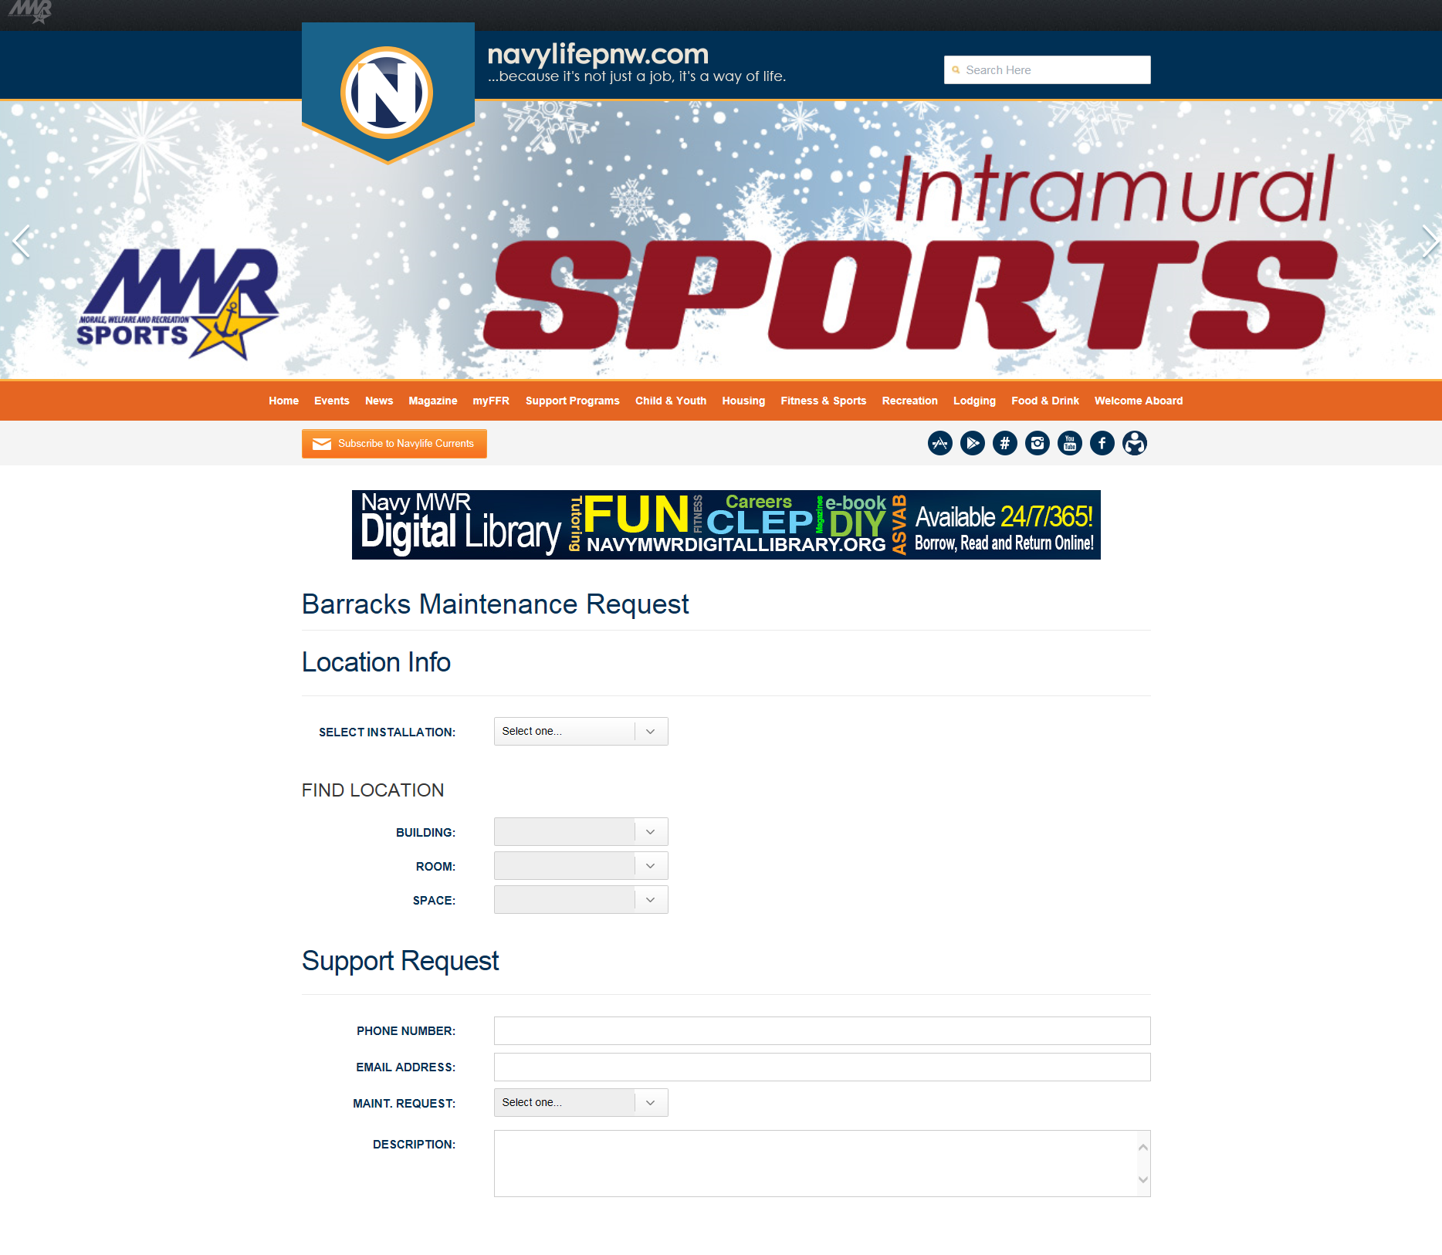
Barracks Maintenance Request ONLINE
(for routine requests only)
http://kitsap.navylifepnw.com/housing/unaccompanied-housing/barracks-maintenance-request

Slide 7
KEYS
Keys available at NGIS
Key issues:
“One-shot key” available at the NGIS 24/7.
  A charge will be added to your account and when you return the key, the charge will be removed.
What to do with keycard readers when: (2302/2306)
  Flashes yellow to green means your batteries are dying
  Flashes orange means that the dead bolt is on.
  Flashes red means that either the key or programming is bad.
  Flashes green to red means your battery is completely dead.

Slide 8
KEYS – cont’d
  During working hours contact your Building Manager in bldg. 2300.
  After hours contact the UH Duty Manager. 360-340-0047
  Room keys are not to be given to anyone except who there were assigned to.

Slide 9
Maintenance
You are our main source of reporting needed repairs.
You may submit routine maintenance request online at http://kitsap.navylifepnw.com/housing/unaccompanied-housing/barracks-maintenance-request
or by stopping by your local UH Office.
Routine maintenance submitted to the Base Operating Service Contractor maintenance team may take up to 30 days to be completed.

Slide 10
Maintenance cont’d
Maintenance Emergencies:
  If you have any room emergencies (i.e.: water, heat, or power issues) call the UH Office during business hours or call the UH Duty Manager after business hours at 360-340-0047.
Light Bulbs:
  If your furniture light bulb burns out and you can SAFELY remove them, bring the bulb to the UH Office and we can give you a replacement. If you can’t get the bulb out safely, let us know so we can get it changed for you. Overhead lighting requires maintenance to change them out and maintenance can sometimes take 30 days to complete so please don’t wait for all lights to go out prior to reporting. Ask – because multiple lights out in one area or if the area only has one light source, we may be able to have maintenance make it a higher priority.

Slide 11
Maintenance
Window Screens:
  Do not remove or damage your window screens. Report damaged window screens immediately to your UH Office.
Mildew:
  Use cleaner at least once a week to clean your bathrooms and window sills.
  Products with mold/mildew remover in their name are ideal for this process.
  Spray on, leave set for 10 minutes and then wipe away.
  For windows that have condensation, you are responsible for cleaning them regularly to prevent mildew from growing.

Slide 12
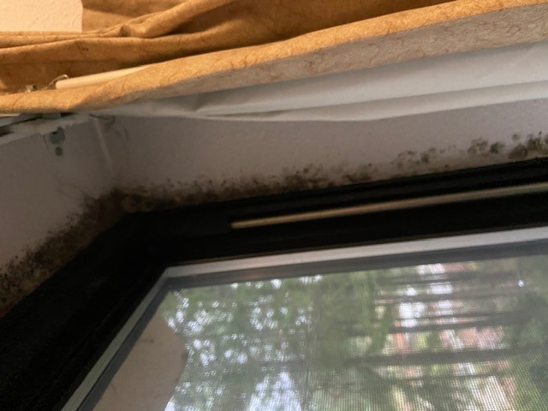
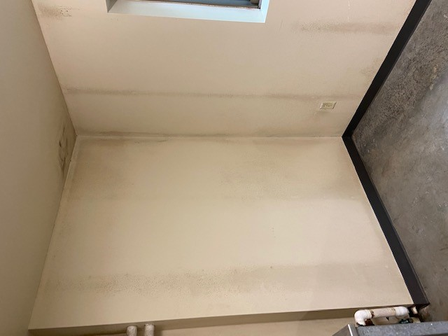


Molds/Mildew and Bed Bugs
Report to any UH representative if you suspect Mold/Mildew or Bed Bug in your room ASAP!.

Slide 13
US Mail and package delivery
Mail:
  UH does not have mail services. All personal mail needs to be sent to your command or you may get a mailbox at the post office to receive your mail.
Packages:
  Items that you purchase from online sources are not authorized to be delivered to your room in UH.
  Please have delivered either to your command or your mailbox.

Slide 14
Rules- Room Inspections
Room Inspections
  All resident rooms are subject to inspection at any time.
  Common areas may be inspected anytime.
    Common areas within the resident rooms to include any areas shared with other residents such as living spaces, bathroom areas, kitchen facilities, and closets. Any storage areas, desks, or drawers which are accessed by multiple residents are considered a common area.
    Common areas also include any area that is in plain view to the person conducting the inspection.
  Private areas will not be considered a common area and will be subject to inspection only after command authorization or consent from the resident.
    Private areas are those areas that can be locked and secured within the rooms of the resident.
    Examples of private areas include lockers or drawers must be locked by individual residents.

Slide 15
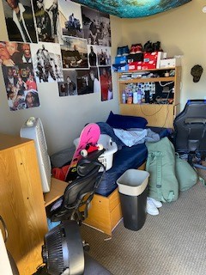
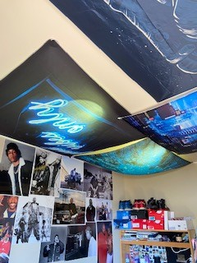
Room Inspections cont.

Slide 16
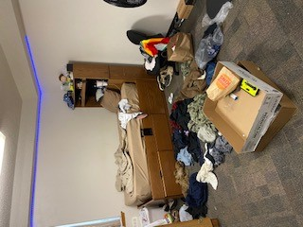
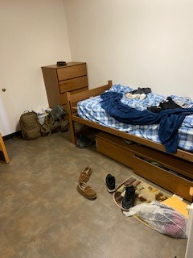
Room inspections cont.

Slide 17
Rules - Alcohol
Alcohol (Per COMNAVREGNWINST 11103.1D): Alcohol consumption shall be in accordance with state and local laws and be restricted to private rooms and/or Commanding Officer designated lounges, picnic areas and/or common area kitchens. Check with local UH Management for base-specific alcohol consumption restrictions in common areas.
  Personnel under 21 years of age will not consume or possess alcoholic beverages in any UH facility.
  Residents over 21 years of age are allowed to have alcohol in their room. State law prohibits consumption of alcoholic beverages by anyone under the age of 21.
  In shared rooms with residents under 21 years of age, all alcoholic beverages will be secured when the resident who is 21 or older is not present.

Slide 18
Rules - Alcohol
  Drunkenness and/or abuse of alcoholic beverages will not be tolerated.
  Use of alcoholic beverages is a privilege and may be revoked.
  Alcoholic beverages in glass containers are strictly prohibited in UH common areas.
  Empty bottles of alcohol will not be displayed as trophies
  Beer and wine may be kept in the refrigerator if both occupants of the room are over 21 years of age.
  Unsecured alcohol is subject to confiscation.
  Check with the UH front desk to confirm the age of your roommates if you are unsure.
MCSFBn personnel must also read and adhere to their Command alcohol policy

Slide 19
Guest Policy
Guest Policy:
  In room visitation may occur between 0900 – 2200, Sunday through Thursday and 0900 – 2300 on Friday, Saturday and the night before all Federal holidays.
  Overnight guests are not authorized.
  Guests are permitted provided they do not interfere with good order and discipline and are not an inconvenience to other residents.
  Non-family in-room guests must be at least 18 years old and have a valid photo identification card in their possession.
  The sponsor (registered occupant) of any guest is responsible for the guest’s actions and must accompany the guest at all times.
  Room keys are not to be given to a guest.

Slide 20
Rules – Smoking
Smoking/Smoke Detectors:
  NO smoking and NO burning of anything–
    candles, incense, or any other flammable items in resident rooms or buildings. E-cigarettes, hookahs and smokeless tobacco are included in this policy.
  Smoking is permitted ONLY in designated areas.
  No altering, disarming, disconnecting or otherwise tampering with smoke detectors or fire extinguishers. Includes covering up smoke detectors.
  Authorized areas are approved and designated by a butt can. Because of the required distances from smoking areas to entrances and intakes. Please DO NOT MOVE the cans.
  Violators are punishable by UCMJ article 92 under NBK instruction.

Slide 21
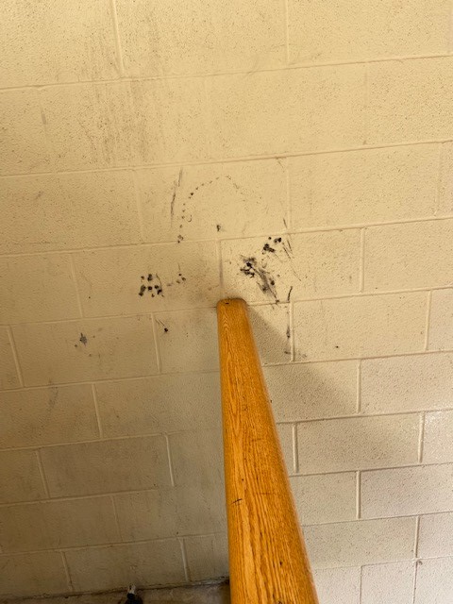
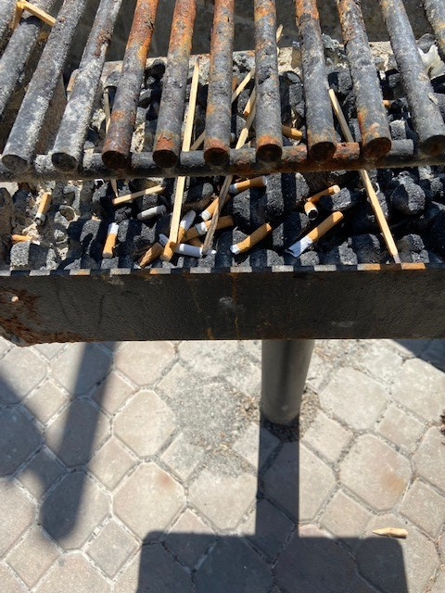
Rules -Smoking cont.

Slide 22


Rules - Weapons
Prohibited in the UH Room
Any kind of weapon and ammunition including BB’s and Paintball, Nerf guns, Knives, Bow and Arrow.
Bleach
Walls: Nothing bigger than a push pin. No double-sided tape.
No pornographic, inappropriate or offensive materials can be displayed in your room.
(This list is not all inclusive, a more detailed list is available; ask your Building Manager or UH front desk personnel.)

Slide 23
Additional Prohibited Items
Prohibited in the UH Room
  Car Parts (clean or dirty)
  Charcoal, lighter fluid (both charcoal and cigarette)
  Space heaters (unless issued by UH)
  Air conditioners,
  Pets of all types and sizes
  Oils and gasoline

Slide 24
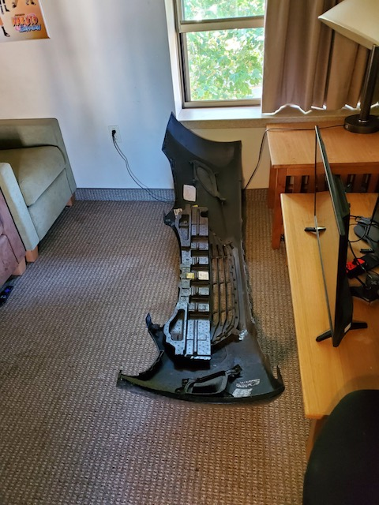
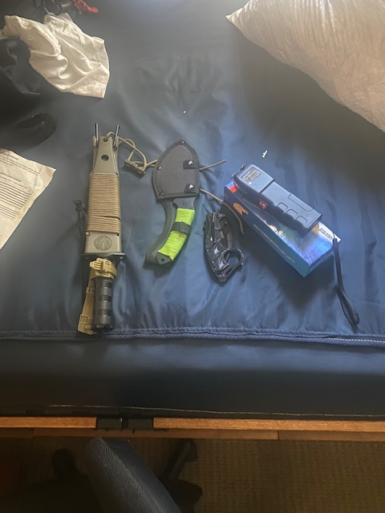
Prohibited Items cont.

Slide 25
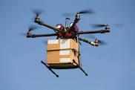
Drones
Naval Base Kitsap is restricted airspace
Drones are not allowed in any Naval Base Kitsap airspace, IAW NBKInst. 5530.14B, and if they are, pilots will be subject to UCMJ and possible Federal
prosecution.

Slide 26
Rules – Cooking in rooms
Cooking In Rooms: Due to the high cleanliness standard necessary to reduce insect and rodent infestation in living spaces in UH facilities,
  Cooking in rooms without kitchens is not authorized except for microwave ovens, and coffee makers with automatic shut off. Unplugged/clean small appliances (i.e.. blender) can be stored in rooms and utilized in common area kitchens. Never leave food unattended while cooking on a stove, microwave ect..
  Common-use kitchens, where available, are provided for your use. Do not put food on the stove to cook and leave unattended. You must clean the area thoroughly after each use and remove all food and trash to include what is in the common refrigerator. Common-use kitchens may be locked for failure to comply with this regulation.

Slide 27
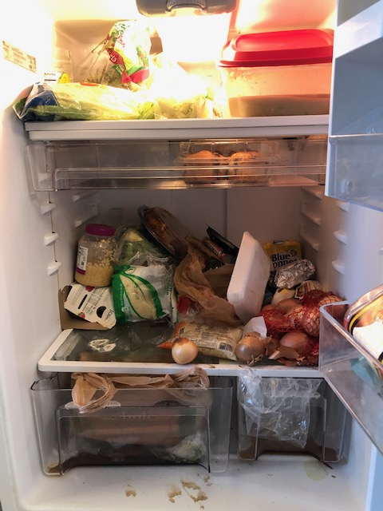
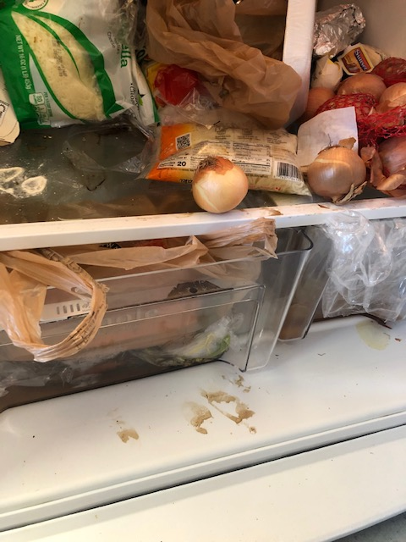
Common Area - Kitchen

Slide 28
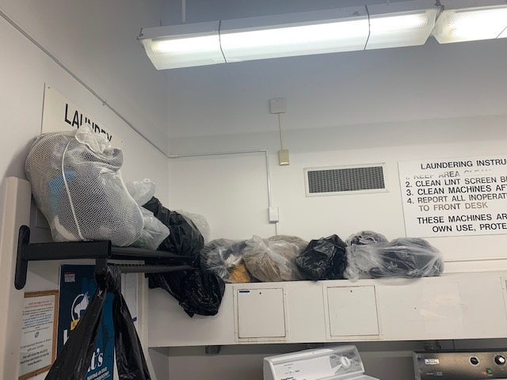
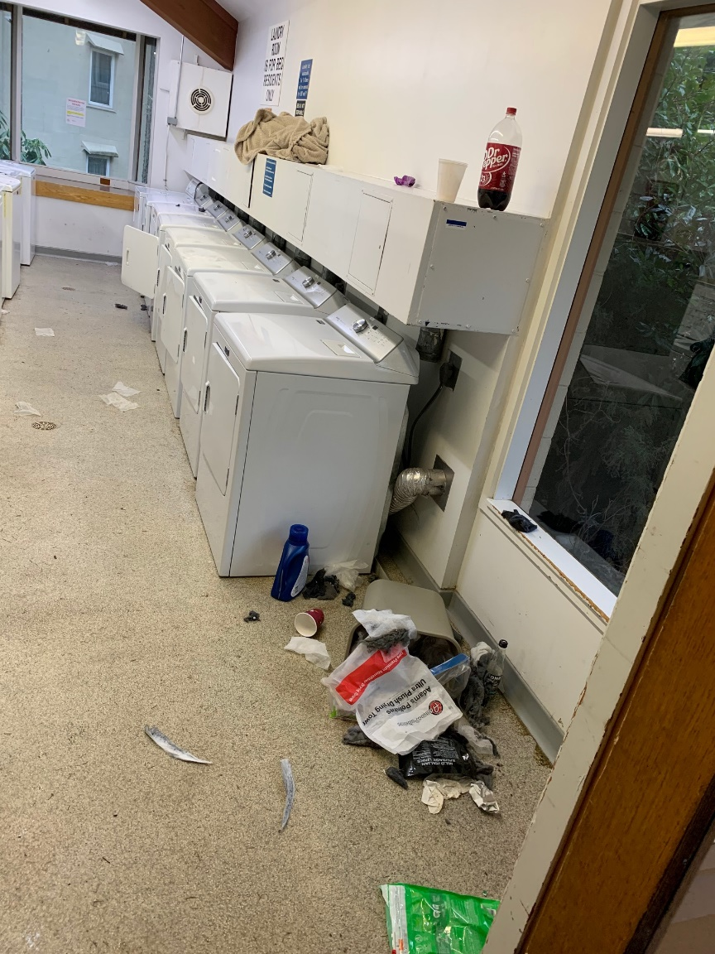
Common Area - Laundry

Slide 29
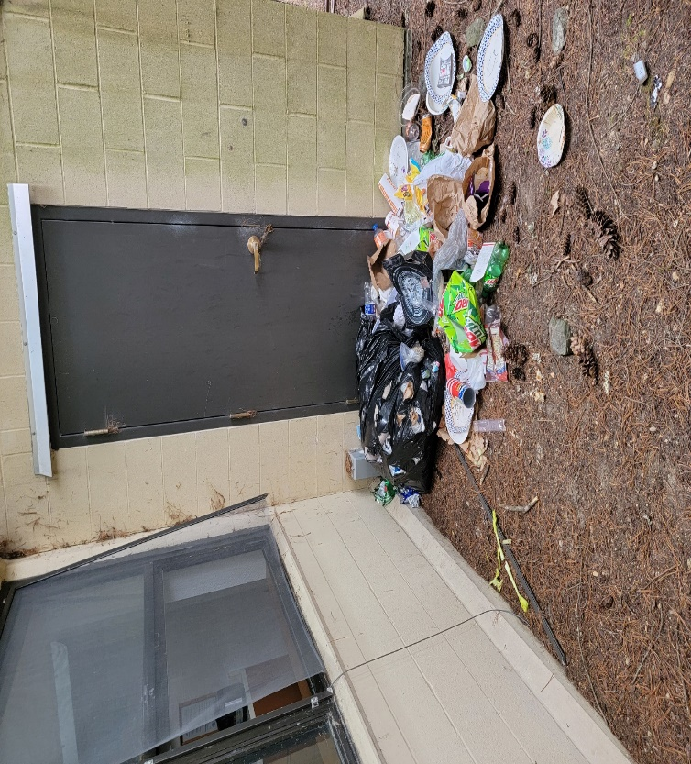
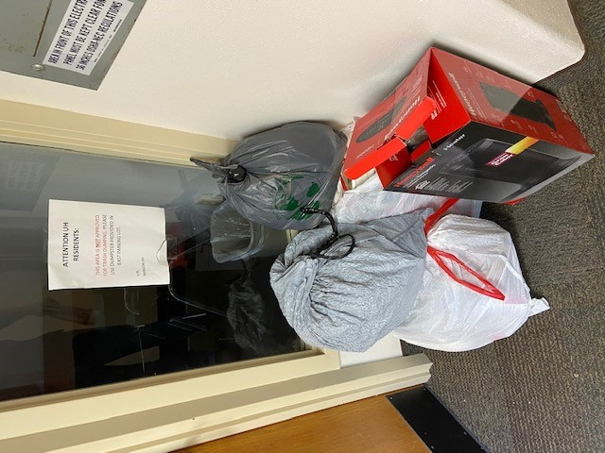
Rules - Trash
Trash:
  All trash must be bagged and placed in applicable dumpsters or designated trash chutes.
  Residents will be charged for trash in common areas or disposed or improperly

Slide 30
Parking
  Parking permits are required to park in UH designated parking areas. Motorcycles must use the designated motorcycle parking areas.
  To obtain your parking permit, please be sure to bring your ID and vehicle registration to the UH front desk.
  UH Parking lots are for UH Residents only
  The parking permit must be displayed on the outside of the lower left corner of the rear window.
  UH residents will only be authorized 1 vehicle parking permit.
  All lost permits must be reported
  Parking permits must be returned if you sell the vehicle or upon your check-out.
  No maintenance will be done in the parking area, to include car washing. Violators are punishable by UCMJ article 92 under NBK instruction.

Slide 31
TRANSPORTATION ON/OFF BASE
BANGOR
On base transport via Blue Bus Route
-FREE Runs Daily 0545-1745 with designated stops near barracks to piers.
Off base bus travel to Downtown Bremerton, Silverdale.
-Kitsap Transit Bus Route
  NEX Bus Stop to Silverdale Transit Center ($2 one-way)
  NEX Bus Stop to Downtown Bremerton/Seattle Ferry ($14 round-trip)
Seatac Airport
  Kitsap Bus Route to Downtown Bremerton/Seattle Ferry to Seattle Light Rail at Pioneer Station ($5 one-way)
  Bremerton Kitsap Airporter ($30 one-way) *PICK-UP IS OFF BASE*
http://kitsap.navylifepnw.com/welcome-aboard/getting-around

Slide 32
TRANSPORTATION ON/OFF BASE
BREMERTON
On base transport via Blue Bus Route
-FREE Runs Daily 0545-1745 with designated stops near parking garage, barracks to piers.
MCSFBN travel between Bremerton/Bangor
  0330 pickup Bremerton (B-847) to Bangor Lower Base (7 days a week)
  0630 pickup Bremerton (B-847) to Battalion Logistics (M-F)
  1530 pickup Bremerton (B-847) to Bangor Lower Base (7 days a week)
  1600 pickup Battalion Logistics to Bremerton (B-847) (M-F)
  1900 pickup Bangor Lower Base to Bremerton (B-847) (7 days a week)
Seatac Airport
  Walk to Downtown Bremerton/Seattle Ferry to Seattle Light Rail at Pioneer Station ($FREE)
  Kitsap/Bremerton Airporter ($30 one-way) *PICK-UP IS OFF BASE*
http://kitsap.navylifepnw.com/welcome-aboard/getting-around

Slide 33
Parking- Bicycles
Bicycles:
  Residents bicycles will be registered per installation and UH office requirements.
  Residents are required park their bicycles in the designated bicycle racks or lockers.
  Residents are urged to use bicycle locking devices to prevent theft.
  Bicycles will not be stored in rooms, stairwells, passageways, walkways, or in areas that will block fire exits.
  Bicycle helmets are required for all cyclists on federal installations including all UH areas.
  Helmets are highly encouraged for skaters and skateboarders.
  Contact the UH Office for information on bicycle storage or to request exceptions.

Slide 34
Damages
Residents are responsible for lost, missing or damages to UH provided furniture, equipment, and linen. (Including lost keys)
Charges will be assessed:
  Can be paid for via DDform 1131 to PSD or
  DDform 139, Automatic Pay Checkage.
If the charges are disputed, you may request a review in writing by UH Management.
Do you have renter’s insurance?
Notes:
Remind residents that it may be a good idea to get liability insurance-to cover lose or damage of personal property

Slide 35
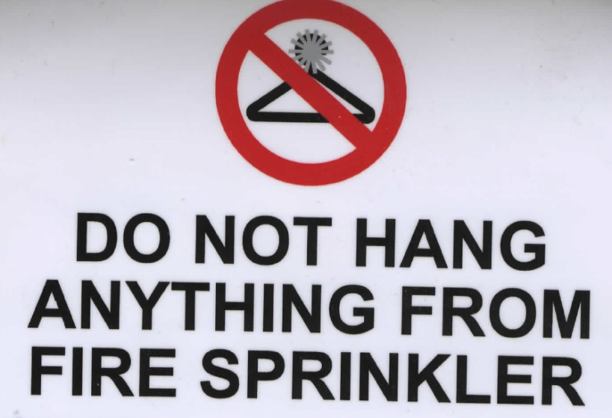
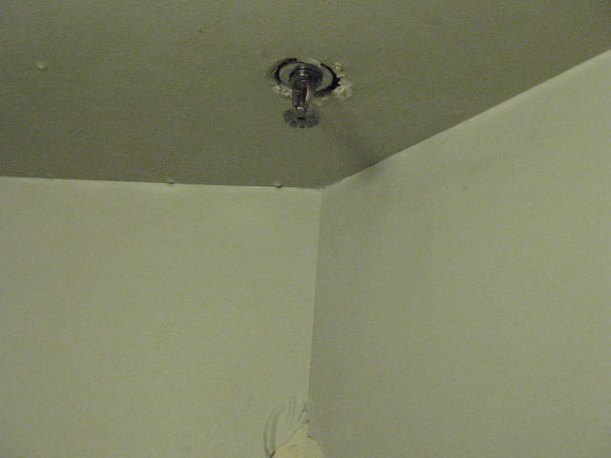
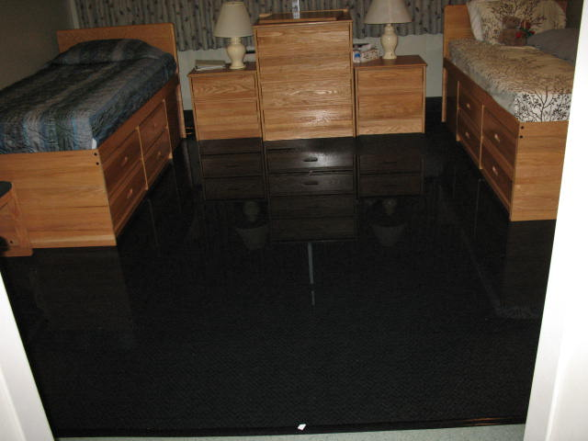
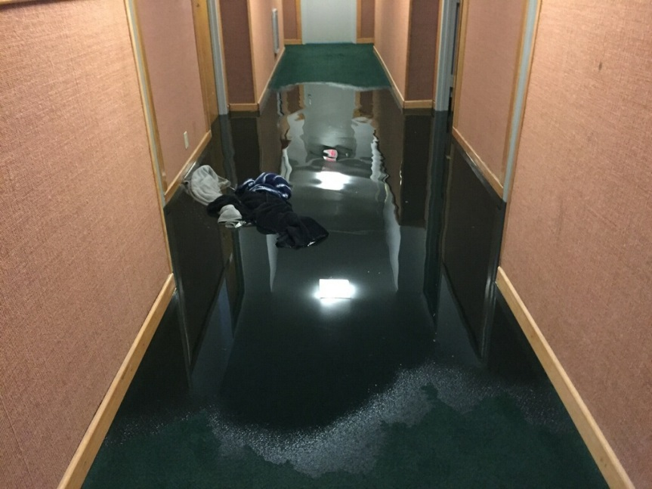
Do not hang anything from Fire Sprinkler

Slide 36
UH Check – Out Procedure
Check In & Check Out Procedures:
  As soon as you receive your orders to move, deploy or separate from Navy, contact your Bldg. Mgr. or UH front desk to schedule a Pre-Inspection.
  All inspections must be scheduled in advance
  Room inspections must be performed by the Building Manager for any resident checking in or out ONLY within the hours of 0730 to 1530 Monday through Friday (excluding Federal holidays).
  All residents who are checking out must notify the Front Desk 30 days prior to departure in order to complete room inspection.
  Exceptions and group check-outs must be pre-arranged with the UH Office.

Slide 37
Navy Gateway Inns and Suites (NGIS)
Bangor/ Keyport/ Perch Pickerel - (building 2750)
  360-930-6830
Bremerton – (building 865)
  360-824-3337
Naval Hospital performs their own check-in/out services.
  360-475-4334
NGIS is contracted to issue keys and complete check-in and check-out paperwork.

Slide 38
Resident Advisor (RA) Program
UH RA Program provides you with senior leadership in the barracks during the evenings, weekends and holidays
RAs are responsible for:
  Serving as your mentor and counselor
  Enforcing local policies
  Conducting Resident meetings to discuss concerns or issues & serve as liaison with UH management
  Coordinating room inspections with Building Managers and Commands
Notes:
This slide is a template for topics to be discussed; additional topics may be added for local use
-Identify RAs: name and location; provide contact information as appropriate
-CNICINST 11103.13 Unaccompanied Housing Resident Advisor Program policy defines RA responsibilities for RAs. The RA discussion in the Orientation should identify the benefits of the RA and various interactions the RAs may have with the residents.

Slide 39
UH Residents’ Role in Sexual Assault
Prevention & Response (SAPR)
As per the SAPR Training received at your Command Indoctrination, all Sailors have the power to prevent & respond to sexual assault:
  Utilize Bystander Intervention Strategies
  Reduce your own Risk
  Report any safety and security issues to security immediately (ex. potential situation where you do not feel safe intervening), and inform UH Staff.
  For more information or assistance:
  DoD Safe Helpline: Call 1.877.995.5247, go to www.safehelpline.org, or text 55-247 (inside the U.S.) or 001-202-470-5546 (outside the U.S.)
  Installation 24/7 SAPR Response Number: 360-340-7037
Notes:
SLIDES 5-7 are to be incorporated without edit. These slides are approved for UH New Resident Orientation by CNIC N91/93. Any changes to content, other than adding local contact information, will be distributed by CNIC.
Reporting to security/UH staff:
Remind participants that a report of sexual assault made through UH staff or to base security will automatically be an unrestricted report because base security and UH staff, including RAs, are not in the protected sphere of individuals who can accept a restricted report (i.e.., SARCs, SAPR VAs, healthcare personnel).
Remind participants: It takes leadership and courage to step in and prevent shipmates and friends from being abusive or pushing appropriate boundaries and limits.

Slide 40
SAPR - Bystander Intervention
Be an active bystander: intervene if you witness a situation that could lead to sexual assault
  Direct Intervention: Directly speak with the person about possibly violating the law and codes of conduct, or ask if everything is okay.
  Indirect Intervention: Ask a friend or authority figure to intervene.
  Distraction: Create a distraction or diversion to remove someone from a risky situation.
  Separation: Step in and separate the two people. Let them know your concerns and reasons for intervening.
  Contact security if you can not intervene or do not feel safe intervening.
  Report all improper conduct to security immediately.
Notes:
Reiterate to participants that Bystander Intervention (BI) is a form of sexual assault prevention, meaning that it helps prevent sexual assault from occurring in the first place. Remind participants that, if they do not feel safe intervening, they should immediately contact base security and inform UH Staff.
Some examples:
Direct Intervention:
Go up to either the potential perpetrator or victim and ask if everything is okay.
Go up to the potential perpetrator and tell them you see what they’re doing and think they could possibly violate the law and/or codes of conduct.
Tell the potential perpetrator to leave the potential victim alone.
Ask the potential victim if she or he would like any help getting home safely.
Indirect Intervention:
Go find another member of your unit and ask them for help.
Go find the potential perpetrator or victim’s friends and urge them to remove him or her from the situation.
Alert the RA or other authority figure if you are concerned that a situation could lead to sexual assault.
Distraction:
Tell the potential victim that their friends are looking for them.
Tell the potential perpetrator that their car is getting towed, their friends are looking for them, etc.
Separation:
Pull either the potential perpetrator or victim to the side and let them know your concerns and reasons for intervening.
Directly separate the two people at the same time, and let them know your concerns.

Slide 41
SAPR - Reduce Your Risk
Trust your instincts and be yourself
Stick with your friends and watch out for each other
Use your cell phone as a tool
Communicate clearly about limits
Don’t be afraid to hurt someone’s feelings, leave a situation if you feel uncomfortable or unsafe
Contact Security if you feel threatened
Notes:
Reiterate to participants that risk reduction is not a form of sexual assault prevention. Only a perpetrator can truly prevent sexual assault by not committing the crime in the first place.
Trust your instincts and be yourself. If you feel unsafe, or even uncomfortable, in any situation, go with your gut. Don’t worry about what others think; your own safety comes first.
Stick with your friends and watch out for each other. Arrive together, check in with one another throughout the night, and leave together. If a friend seems out of it, or seems too intoxicated for the amount of alcohol they’ve had, or is acting out of character, get him or her to a safe place. If you suspect that your friend has been drugged, call 911. Be explicit with the health care provider so they can administer the correct tests. You can also call the Safe Helpline (877-995-5247)for information and support if you think a sexual assault may have occurred.
Use your cell phone as a tool. Make sure it’s fully charged before you leave home, and if you find yourself in an uncomfortable situation, shoot a quick text for a “friend-assist.” Make a plan before you go out just in case your phone dies or loses signal, so you can meet up with your friends at a specific location at a certain time.
Communicate clearly about limits. By communicating openly with each other, you ensure that you are both aware of each other’s limits from the beginning. Both verbal and nonverbal (body language) communication can be used to ensure the message is understood.
Don’t be afraid to hurt someone’s feelings. If you find yourself in an unsafe situation, it’s okay to come up with an excuse as to why you have to go. It’s better to make up a reason to leave than to stay in a possibly dangerous situation. Your safety comes before someone else’s feelings.
If you see something, say something! Intervene if a situation seems questionable or if someone’s safety is at risk. By taking action you can prevent a crime from being committed. Remember you can also contact military or civilian law enforcement.

Slide 42
UH Offices
Bangor / front desk
  360-396-4046 - Building 2300 Bangor
Bremerton front desk
  360-476-2377 - Building 1001 Bremerton
Naval Hospital front desk
  360-475-4334
  Building HP05 Naval Hospital
Keyport / Perch-Pickerel front desk
  360-315-7679 - Building 3147 Pickerel

Slide 43
Questions?
Your Opinion Counts
CIS – Continuous Improvement Survey
https://www.surveymonkey.com/r/99PGGY7

